Slide 1
Deep Learning –Training Program Update

Slide 2
Deep Learning Specialization – Intermediate
Neural Networks and Deep Learning | Improving Deep Neural Networks | Structuring Machine Learning
NN Basics Numpy Vectorization Logistic Regression Gradient Descent Activations Forward Backward Propagation | Input Normalization Bias / Variance Data augmentation Regularization – L2, Dropout Gradient Descent Types Momentum, RMS Prop Adam Optimization Hyper Parameter Tuning Softmax Tensor Flow Basics | Approaching ML problem Evaluation Metric Setting Benchmarks Error Analysis, Train/Dev/Test Distributions Transfer Learning

Slide 3
Deep Learning Specialization – Advanced
Convolutional Neural Networks (CNN) | Sequence Models
CNN – Convolutions, Pooling Standard Architectures - AlexNet, VGG, ResNet, Inception Object Localization Landmark Detection YOLO algorithm Siamese Network Face Recognition and Verification | RNN Language Model Word Embeddings Attention Algorithm Trigger Word Detection Music Generation Neural Style Transfer Natural Language Translation

Slide 4
Course Completion Status
S.No | Name | Neural Network and Deep Learning | Improving Deep Neural Network | Structuring Machine Learning | Convolutional Neural Network | Sequence Models
1 | Dinesh Babu Rengasamy |  |  |  |  | 
2 | Dakshin Jawahar |  | 
3 | Raju E |  | 
4 | Guruprasad Rajendran |  | 
5 | Prabhu Srinivasan |  | 
6 | Sai Saran |  | 
7 | Pooja Dawada |  | 
8 | Nisha Singh |  | 
9 | Aravind Raj Palaniswamy |  | 
10 | Manas Rai | 
11 | Hemanth K | 

Slide 5
Objective and Dataset
Objective
To create a ML model to predict Demographics based on history of transactions.
UCI Credit Card Dataset
This dataset contains information on default payments, demographic factors, credit data, history of payment, and bill statements of credit card clients in Taiwan from April 2005 to September 2005.
Variable | Description
ID | ID of each client
LIMIT_BAL | Amount of given credit in NT dollars (includes individual and family/supplementary credit
SEX | Gender (1=male, 2=female)
EDUCATION | (1=graduate school, 2=university, 3=high school, 4=others, 5=unknown, 6=unknown)
MARRIAGE | Marital status (1=married, 2=single, 3=others)
AGE | Age in years
PAY_0, PAY_2, PAY_3, PAY_4, PAY_5, PAY_6 | Repayment status(Apr - Sep), 2005 (-1=pay duly, 1=payment delay for one month, 2=payment delay for two months, ... 8=payment delay for eight months, 9=payment delay for nine months and above) and so on for respectively for months backwards
BILL_AMT1, BILL_AMT2, BILL_AMT3, BILL_AMT4, BILL_AMT5, BILL_AMT6 | Amount of bill statement(Apr - Sep), 2005 (NT dollar) and so on respectively for months backwards
PAY_AMT1, PAY_AMT2, PAY_AMT3, PAY_AMT4, PAY_AMT5, PAY_AMT6 | Amount of previous payment (Apr - Sep), 2005 (NT dollar) and so on respectively for months backwards
default.payment.next.month | Default payment (1=yes, 0=no)

Slide 6
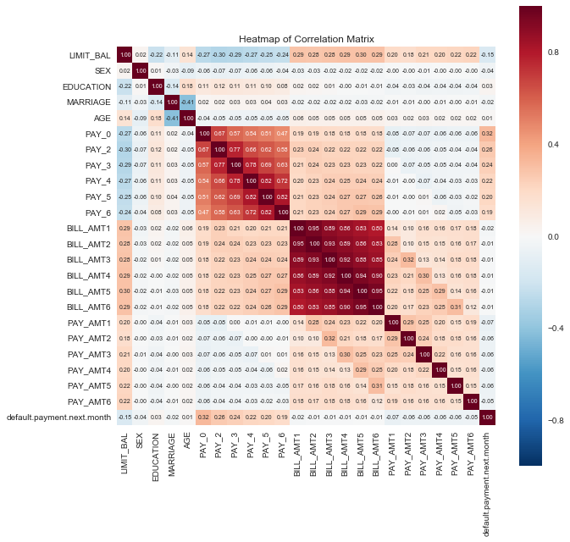
Correlation Matrix

Slide 7
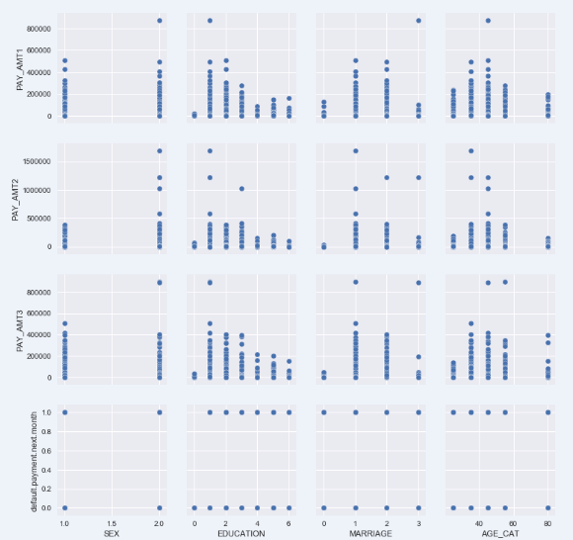
Pair Plot

Slide 8
Network Architectures Used
Neural Network – Single Layer ~ Logistic Regression
Neural Network – Multi Layer
Convolution and RNN (Considering Payments as Sequence)
lnput Layer
n_X - features
m - samples
Output Layer
n_Y - Classes
lnput Layer
n_X - features
m - samples
Hidden Layer
8 Activation Units
Hidden Layer
12 Activation Units
Hidden Layer
16 Activation Units
Hidden Layer
16 Activation Units
Hidden Layer
12 Activation Units
Hidden Layer
8 Activation Units
Output Layer
n_Y - Classes
lnput Layer
n_X - features
m - samples
Convolution
Kernel – 13
Stride – 13
Filters – 1
Output features - 6
LSTM
8 Activation Units
Hidden Layer
8 Activation Units
Output Layer
n_Y - Classes

Slide 9
Accuracy of Architectures
Codes available @ https://gitlab.com/dineshbabur92/UCI-demographics-DL-model/
 | NN - Multi Layer |  | NN - Single Layer(~ LR) |  | NN - Sequence Model |  | Logistic Regression |  | Polynomial Regression
 | Train | Test | Train | Test | Train | Test | Train | Test | Train | Test
Education (6 Classes) | 51% | 53% | 51% | 52% | 47% | 47% | 51% | 52% | 51% | 53%
Age Category (6 Classes) | 43% | 42% | 43% | 42% | 43% | 42% | 39% | 39% | 40% | 39%
Sex (2 Classes) | 60% | 60% | 60% | 60% | 60% | 60% | 61% | 60% | 61% | 60%
Marital status (4 Classes) | 53% | 54% | 53% | 56% | 52% | 54%
Default Payment (2 Classes) |  |  | 78% | 78%
Pay Amt 6 (Linear) |  |  | 84% | 74%

Slide 10
Thank you

